Slide 1





Slide 2


Single Page Applications with
Grant Hamm
IT Architect
Castle Worldwide, Inc
+
Web API 2

Slide 3
What we’ll cover
Why do we care about Single Page Applications
What is Angular’s role in a Single Page Application
What is Web API and how does it fit into our application

Slide 4
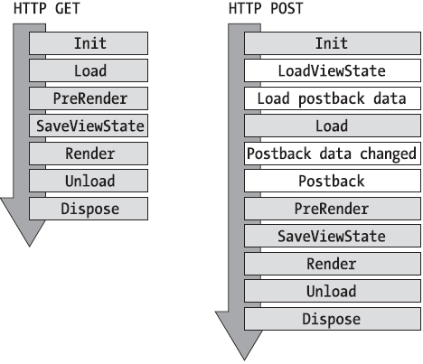

Is There An Easier Way?

Slide 5
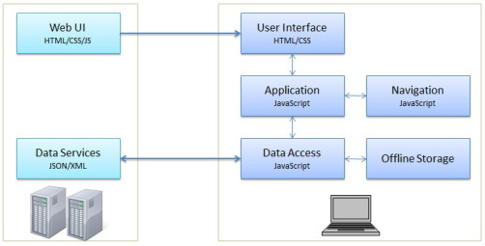
Single page applications

Slide 6
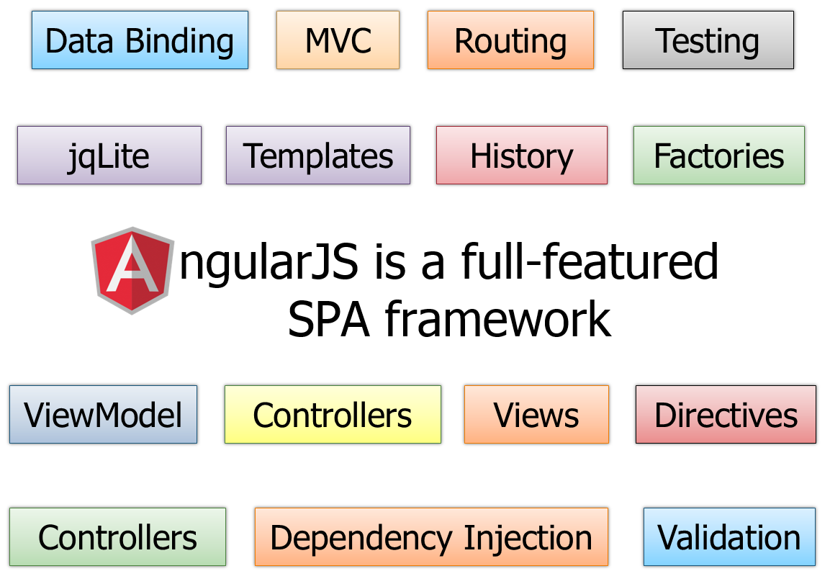
Angular?

Slide 7
Web API
Web API Is Straightforward
Make a RESTful call to an endpoint, get a response
Web API is Flexible
Has a well defined processing pipeline that allows for heavy customization and manipulation for advanced scenarios
Convention over configuration approach make the basics work out of the box
More
Does NOT need to be hosted in IIS.
Can handle data from many sources, allowing complete reuse between view platforms (web/iOS/Android/etc)
High performance, scalability, long term support

Slide 8
Benefits of Web API
Don’t need no SOAP, won’t get no SOAP
Automatic support for Odata
Fancy grids, anyone?
Works out of the box, unlike WCF
Open Source!
While still providing the stability a large enterprise needs
Great for passing arbitrary response types (images, documents, simple text)

Slide 9
Benefits of the entire approach
Separation of concerns
Each piece is GREAT at what it does. It performs that one task exceptionally.
Code simplicity.
There’s no mismatch between the desired output and the framework’s control over the expected output
Testability
All of these technologies support DI and IOC. This makes mocking and testing a very reasonable thing to achieve
The best user experience possible
Users have grown accustomed to page refreshes and static page behavior, but it doesn’t mean that we can’t do better

Slide 10
What We Learned
SPA’s are a pretty natural way to develop an application
Angular is a rich framework that enables all of that SPA goodness in a manner that’s easy to work with, and highly maintainable
Web API is a purpose driven http service provider that makes returning data simple, and straight forward
Web development is pretty awesome these days

Slide 11
Thank You!
Thanks for your time, it’s been a blast!
Twitter: @tghamm
Blog: http://www.granthamm.com
Castle Worldwide: http://www.castleworldwide.com
https://github.com/tghamm (where you’ll find this presentation and code in a day or so)

